Slide 1
My Experiences as an FDA Statistician
Yeh-Fong Chen, Ph.D.
FDA/CDER/OB/DB3
CBA 2016-2017 Workshop series-3
Dec. 18, 2016

Slide 2
Disclaimer
This presentation reflects the views of the author and should not be construed to represent the views or policies of the U.S. Food and Drug Administration.

Slide 3
FDA Mission
protecting the public health by assuring the safety, efficacy and security of human and veterinary drugs, biological products, medical devices, our nation’s food supply, cosmetics, and products that emit radiation
advancing the public health by helping to speed innovations that make medicines more effective, safer, and more affordable
helping the public get the accurate, science-based information they need to use medicines and foods to maintain and improve their health
regulating the manufacturing, marketing and distribution of tobacco products

Slide 4
Centers at FDA
Center for Food Safety and Applied Nutrition (CFSAN)
Center for Veterinary Medicine (CVM)
Office or Regulatory Affairs (ORA)
National Center for Toxicological Research (NCTR)
Center for Biologics Evaluation and Research (CBER)
Center for Tobacco Products (CTP)
Center for Drug Evaluation and Research (CDER)
Center for Devices and Radiological Health (CDRH)

Slide 6
Clinical Trials
Clinical trials: experiments done in clinical research to answer specific questions regarding biomedical or behavioral interventions, including new treatments
Depending on development stages, trials may generate data on safety and/or efficacy.
Drug Development Process:
Investigational New Drug (IND) application: Before Phase 1
New drug application (NDA): Completion of Phase 2 and 3
Phase 0 | Phase 1 | Phase 2 | Phase 3 | Phase 4
P-K and P-D Studies in Humans | Screening for Drug’s Safety | Establishing for Drug’s Efficacy | Final Confirmation of Drug’s Safety and Efficacy | Post-Marking Studies

Slide 7
ICH E9: Statistical Principles for Clinical Trials
Phase 2 Exploratory Trials: dose finding for efficacy
Confirmatory trial: an adequately controlled trial in which the hypotheses are stated in advance and evaluated
Primary vs. Secondary Endpoints
The primary endpoint should be the variable capable of providing the most clinically relevant and convincing evidence directly related to the primary objective of the trial.
Secondary variables are either supportive measurements related to the primary objective or measurements of effects related to the secondary objectives.

Slide 8
FDA Guidance Providing Clinical Evidence of Effectiveness for Human Drug and Biological Products
For drugs approved in US, the sponsors need to demonstrate the drugs are safety and effective with substantial evidence in at least two adequate and well controlled clinical trials.
When only a single adequate and well-controlled study is conducted to demonstrate effectiveness of a new use, pertinent information from other adequate and well-controlled studies of a drug may be considered.

Slide 9
Statistical Hot Topics
Study Designs
Enrichment designs and Adaptive Designs
Determination of Efficacy Endpoint
Continuous vs. Binary Endpoints
Clinical Outcomes vs. Patient Reported Outcomes
Co-Primary Endpoints vs. Composite Endpoints
Key Secondary Endpoints
Multi-Regional Clinical Trials
Missing Data Control and Analysis: LOCF, BOCF, MI, MMRM,…,etc.
Study-wise Type I Error Control in terms of Multiplicity
Subgroup Analysis
Accelerated Approval through Surrogate Endpoint

Slide 10
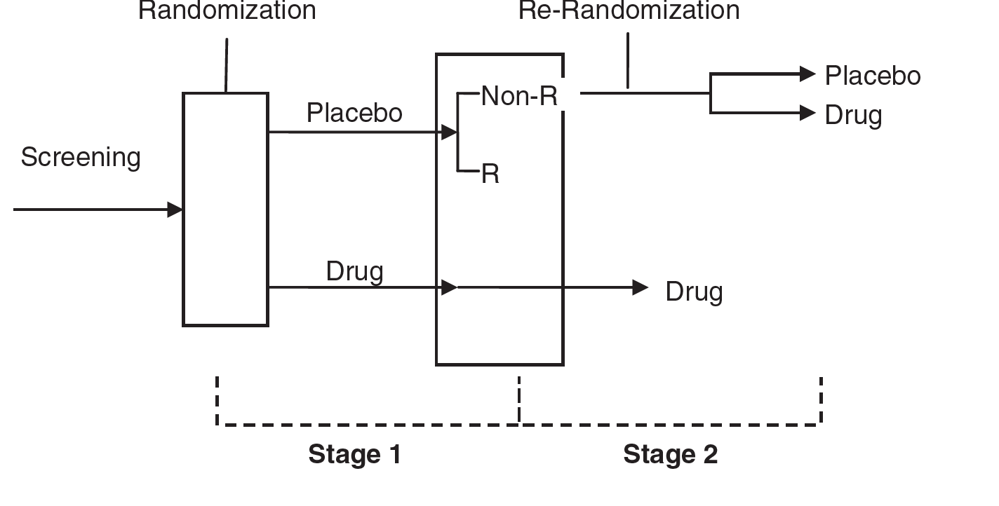
Enrichment Design
Sequential Parallel Design (SPD) for dealing with high placebo response
proposed by Fava et al. (2003) & SPD with re-randomization by Chen et al. (2011)

Slide 11
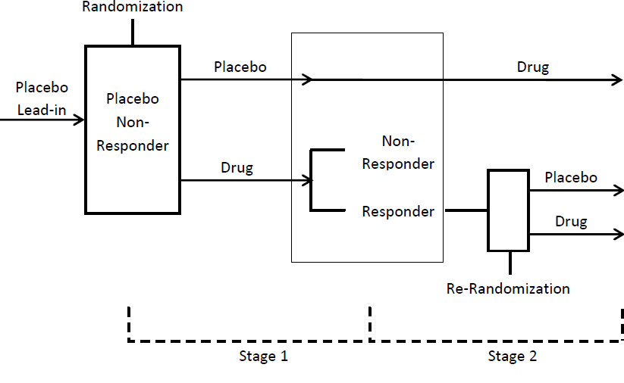
Enrichment Design
Sequential Enriched Design (SED) for Dealing with High Placebo Response & Studying Target Patient Population
Proposed by Chen et al. (2014)

Slide 12
Rationale of SED
The target patient population is those who would respond to a drug but not to a placebo.
A placebo lead-in phase is implemented before randomization to screen out those patients who would respond to placebo at the beginning of the trial.
At the 2nd stage, only patients who are drug responders will be further re-randomized and studied.

Slide 13
Multi-Regional Clinical Trials (MRCT) from Khin et al. 2013
PLATO (Platelet Inhibition And Patient Outcomes) trial
Region | Total N | Ticagrelor N(%) | Clopidogrel N(%) | HR (95% C.I.) | P-Value
Overall | 18,624 | 9,333 (9.8%) | 9,291 (11.7%) | 0.84 (0.77, 0.93) | <0.0003
Non-US | 17,211 | 8,626 (9.6) | 8,585 (11.8) | 0.81 (0.74, 0.90) | <0.00001
US | 1,413 | 707 (12.6) | 706 (10.1) | 1.27 (0.92, 1,75) | 0.146

Slide 14
Schizophrenia MRCT DATA 33 Trials with 12,585 patientsfrom Chen et al., 2010

Slide 15
Treatment Effect by Region & Average from Chen et al. 2010

Slide 16
Conventional Design for Phase 2 & 3

Slide 17
Two-Stage Adaptive Phase 2/3 Seamless Design

Slide 18
Clinical Trials in Pre-cirrhotic Non-alcoholic Steatohepatitis (NASH)
NASH has been recognized as one of the leading causes of cirrhosis in adults and NASH related cirrhosis is currently the second indication for liver transplants in the United States [Younossi ZM et al., 2015]
In a recently published study of 108 Non-alcoholic fatty liver disease (NAFLD) patients who had serial biopsies, 47% of patients with NASH had a progression of fibrosis, and 18%, had spontaneous regression of fibrosis over a median follow-up period of 6.6 years [McPherson S et al. , 2015]
Question: Can any clinical trials for treating NASH be conducted less than 6.6 years? With innovative design?

Slide 19
Phase 3/4 Seamless Design for Accelerated Approval
Phase 3 trial
Placebo controlled
Phase 4 trial
Controlled based on Clinical Benefit Endpoint
Results Observed for Surrogate Endpoint
Full Approval
Submission of marketing application
IA
(SSR)
Notes:
Accelerated approval generally requires that a phase 4 trial be underway at the time of marketing approval to verify and describe the clinical benefit.
This verification, phase 4 trial can be a separate trial, but generally with disease with a long natural history, like PSC it may be more efficient to use a seamless design in which the patients are rolled over from the phase 3 to the phase 4 trial.
General supportive care would be continued in both arms in such a trial.

Slide 20
Challenges with Accelerated Approval Trials
Need to plan far in advance for the entire phase 3/4 trial with the Statistical Analysis Plan submitted prior to trial initiation
Major issue: The overall type I error control
Retention of patients in a placebo-controlled trial after marketing approval
Placebo control is best
Potential for use of historical control, however may lack of data for the sought indication at this time.
Question: Can we consider other types of design?
FDA Guidance for Industry—E10 Choice of Control Group and Related Issues in Clinical Trials (FDA, 2001)

Slide 21
SED to be Considered for dealing with Placebo dropouts at Phase 4
For NASH trials, the placebo lead-in could be replaced by Vitamin E non-responders.

Slide 22
Concluding Remark
Working at FDA as a statistician is rewarding
Making contributions for protecting public health
Personal and professional growth, in particular, have the opportunities to see the overall picture
Many hot topics that Statisticians can help
Ensure the study drugs are safe and effective when marketing in US
Come up with innovative study designs, such as different enrichment designs and adaptive designs to shorten the drug development process

