Slide 1
来大志
Dazhi (Alex) Lai, Ph.D.
Cell: 203-499-8119
Email: alex.lai@speedbiosystems.com

Slide 2
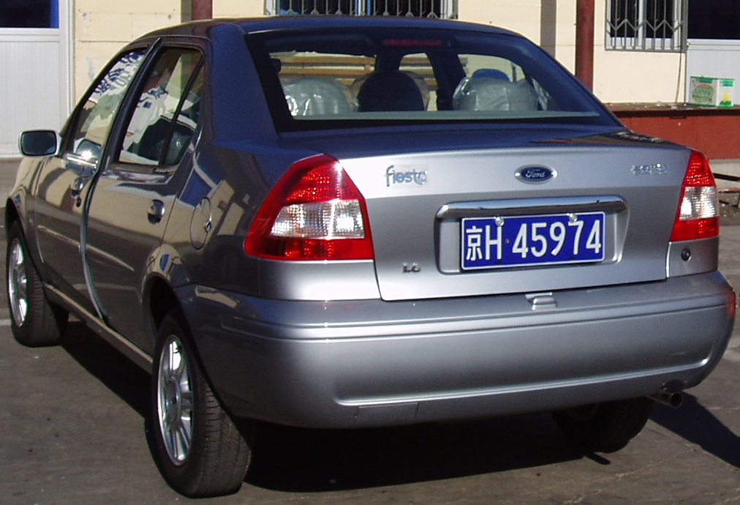
Experience
College: Nankai University, China (4 years)
PhD. The Academy of Military Medical Sciences, China (5 years)
R&D Director. Shadong Biotech, Ltd, China (1 year)
Postdoc1: Yale University (3 years): PNAS
Postdoc2: NIH/NCI (1.5 years): JEM
Postdoc3: NIH/NHLBI (0.5 year)
Scientist: OriGene Technologies Inc (0.5 year)
Owner: SPEED BioSystems LLC
Founder: Magnifygen Inc

Slide 3
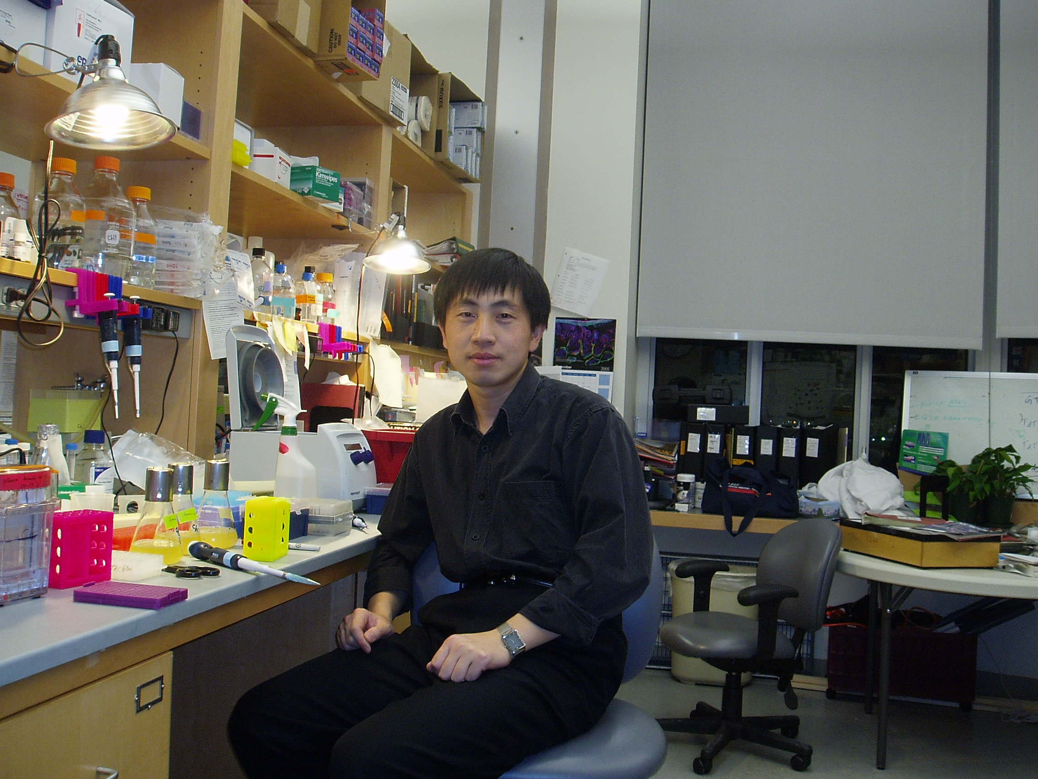

Slide 4
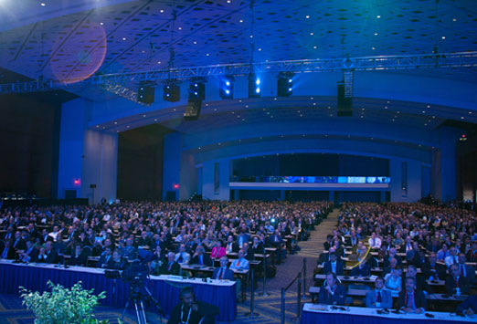

Slide 5
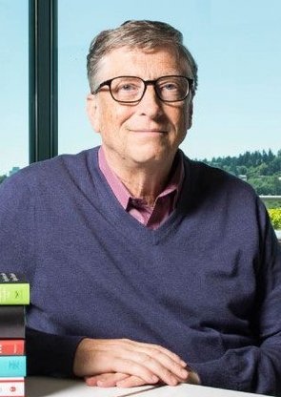
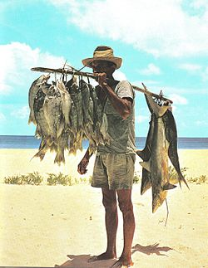
I work so hard, so I can vacation on this island, enjoying the beautiful view.
Freedom
I am already living on this island and enjoying the beautiful view.

Slide 6
Marketing of research reagents

Slide 7
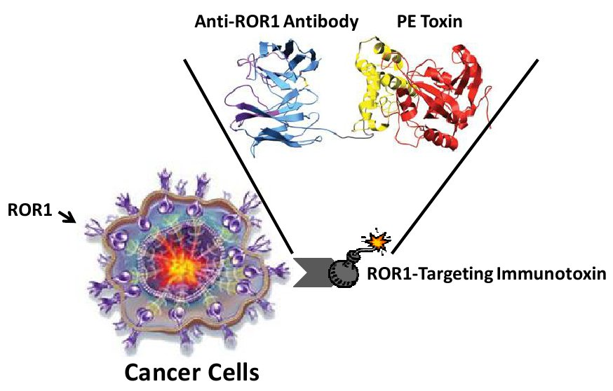
Development of a anti-cancer drug

Slide 8
Starting up your own company
Mindset
Aim: Freedom
Direction: Passion
Feasibility: Ability
Approaches: Think out of the box
Result: Financial independence; Life style

Slide 9
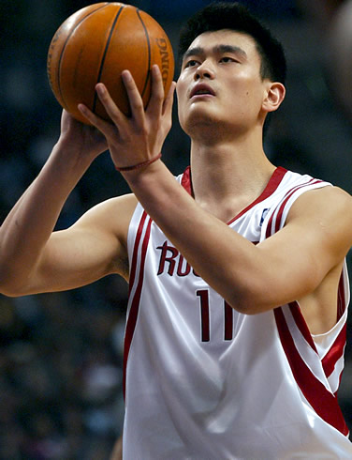
Aim: Freedom

Slide 10
Direction: Passion
Find something that you are crazy about. Something you cannot stop thing about all the time.

Slide 11
Feasibility: Ability
Face the reality.
The field that you are mostly likely successful is the field you are most familiar with.

Slide 12
Approaches: Think out of the box
Make it happen !!!

Slide 13
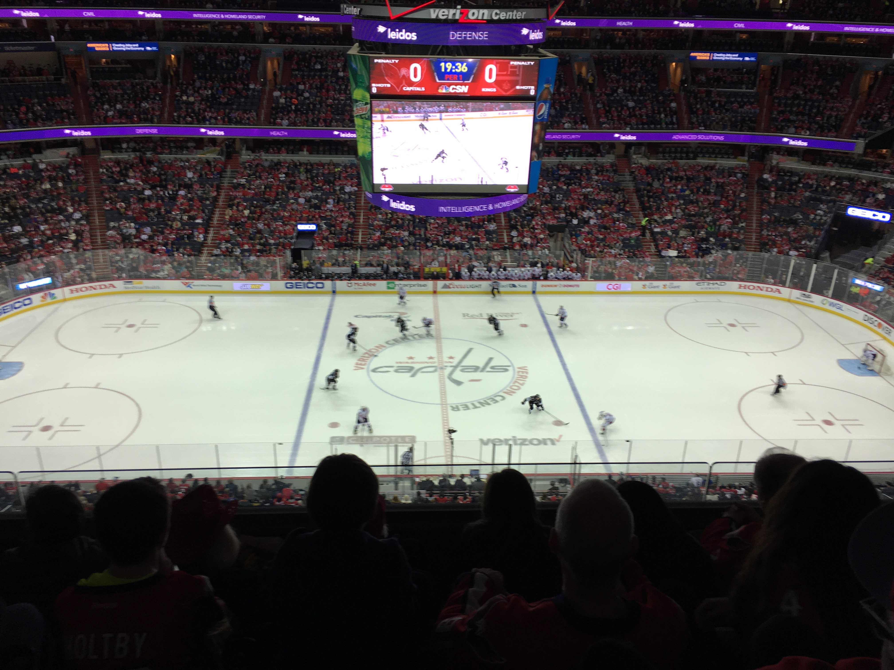
Result: Financial independence; Life style

Slide 14
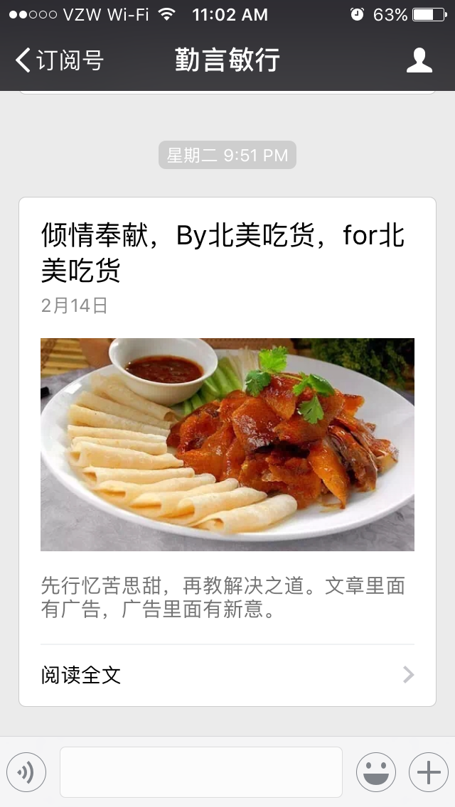
WeChat Public Account iOS App: FriendCooks

Slide 15
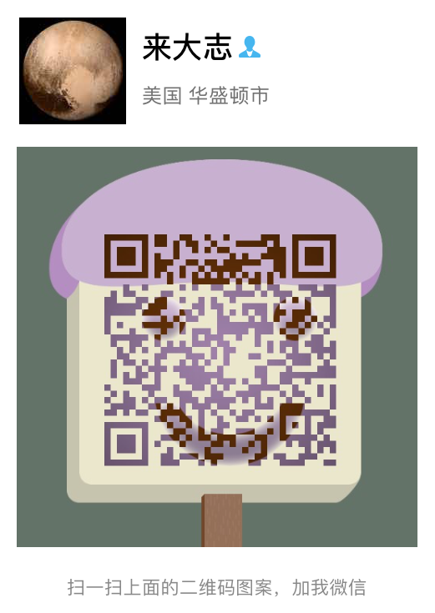
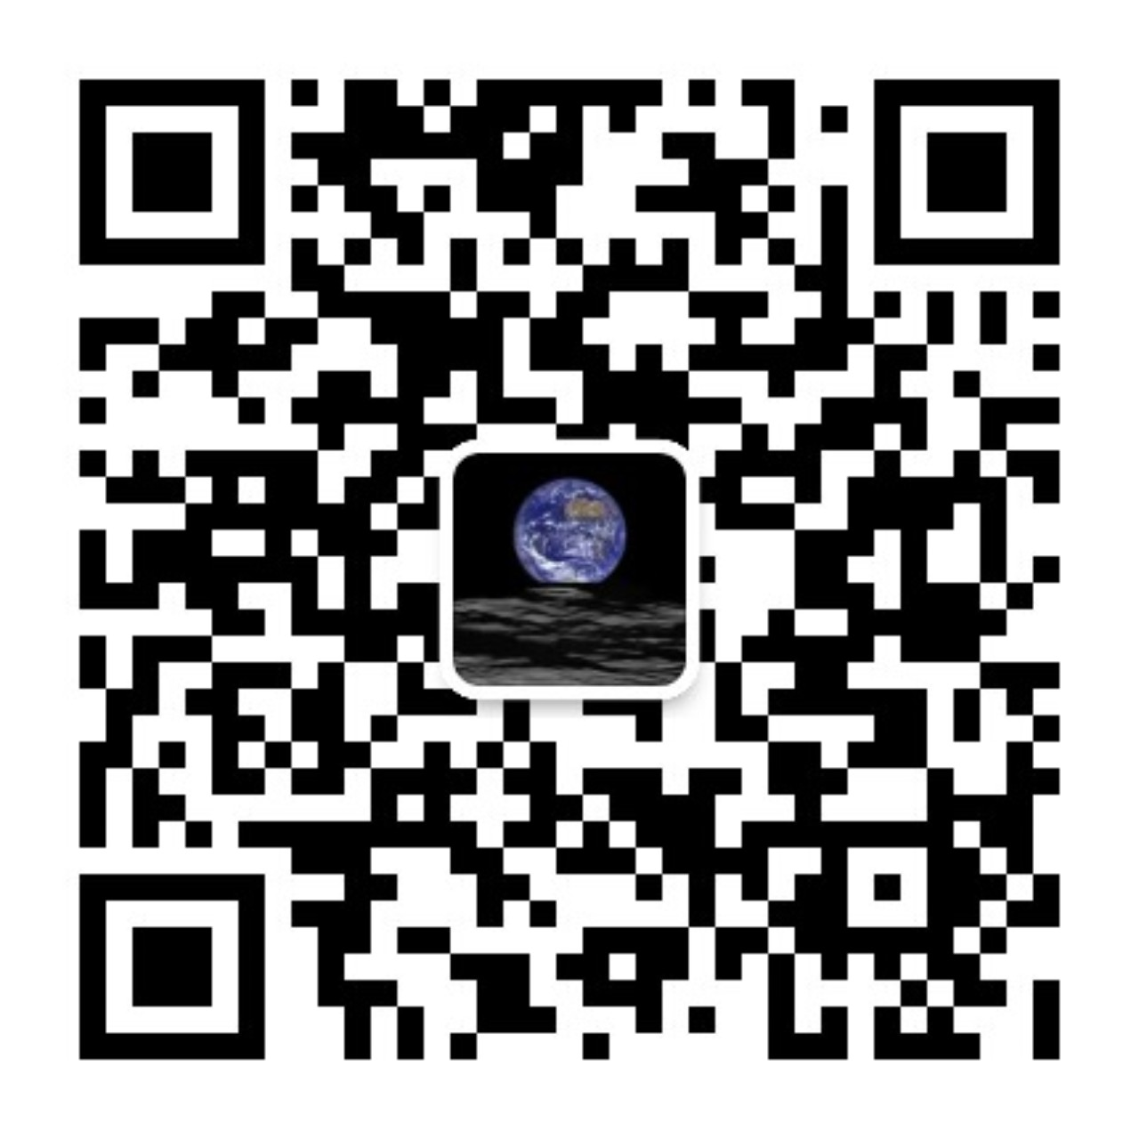
微信公众号：勤言敏行
SPEEDBiosystems.com
Magnifygen.com
iOS App：FriendCooks
Email: alex.lai@speedbiosystems.com
Cell: 203-499-8119

